Slide 1
Summer 2022 REU Documentation

Slide 2
Teacher Feedback

Slide 3

Background
SnapClass is a learning management system (LMS) designed to help teachers manage and grade block-based programming assignments in Snap.
Using Participatory Design, we gather information from three teachers about additional features they would like to have in SnapClass.

Slide 4
Additional Features
Out of the several features the teachers came up with, we narrowed them down and prioritized three features.
Hand-Raising
Differentiated Assignment Level
Self-Assessment

Slide 5
Hand-Raising Feature
The teachers requested a real-time student help feature where students could assist each other with assignments to reduce the load on teachers and further student mastery of topics. Originally, the teacher requested there should be different types of helpers: hand and fist. The purpose of this is to allow assign students to help with multiple topics. For example, a teacher assigns hand helpers to help with conditionals and fist helpers to help with loops and students can request help form hand or fist depending on what they need help with. We decided to simplify this to helpers and non-helpers as a first step and then incrementally add the different helpers afterwards.

Slide 6
Design of the Hand-Raising Feature
We decided to use a helper and a non-helper table as a queue in the database so that non-helpers could be assigned to helpers and removed from the queue of students waiting to be helped. Similarly, helpers are removed from the queue when they are helping a student and added back after they are done.
On session start:
Initialize helper table with the assigned helpers in the session.
On student request for help:
Check if helper table is empty:
If table is empty: add student to the Non-Helper table.
If table not empty: Remove the first helper in the Helper table. That helper will be assigned to help the student.
On helper saying they are done helping a student:
Check if Student table is empty:
If table is empty: add helper to the Helper table
If table is not empty: Remove the first student in the Non-Helper table. That helper will be assigned to that student

Slide 7
Implementing the Hand-Raising Feature
To implement the hand-raising feature we began by adding functionality where teachers could assign students as helpers and non-helpers using a drop down menu in the section roster. We used integer values to represent whether a student is a helper or non-helper. Non-helpers were given 1 as their role while helpers were given 2. The helper roles are saved into the database when the teacher updates the dropdown selection for the student. On system reload, the previously assigned roles for the students are loaded into the software form the database.

Slide 8
Implementing the Hand-Raising Feature (cont.)
We added buttons to the student assignment component to allow students to request help. When a student clicks on the hand icon they are added to a database table that is used as a queue to represent the students’ requests for help. We also added functionality to pull helpers from the user table into a helper table that represents a queue of helpers who are assigned to students.

Slide 9
Details about of Differentiated Assignment Level Feature
Teachers requested level differentiation within assignments to allow for more tailored learning for students that have different levels of mastery of a topic.

Slide 10
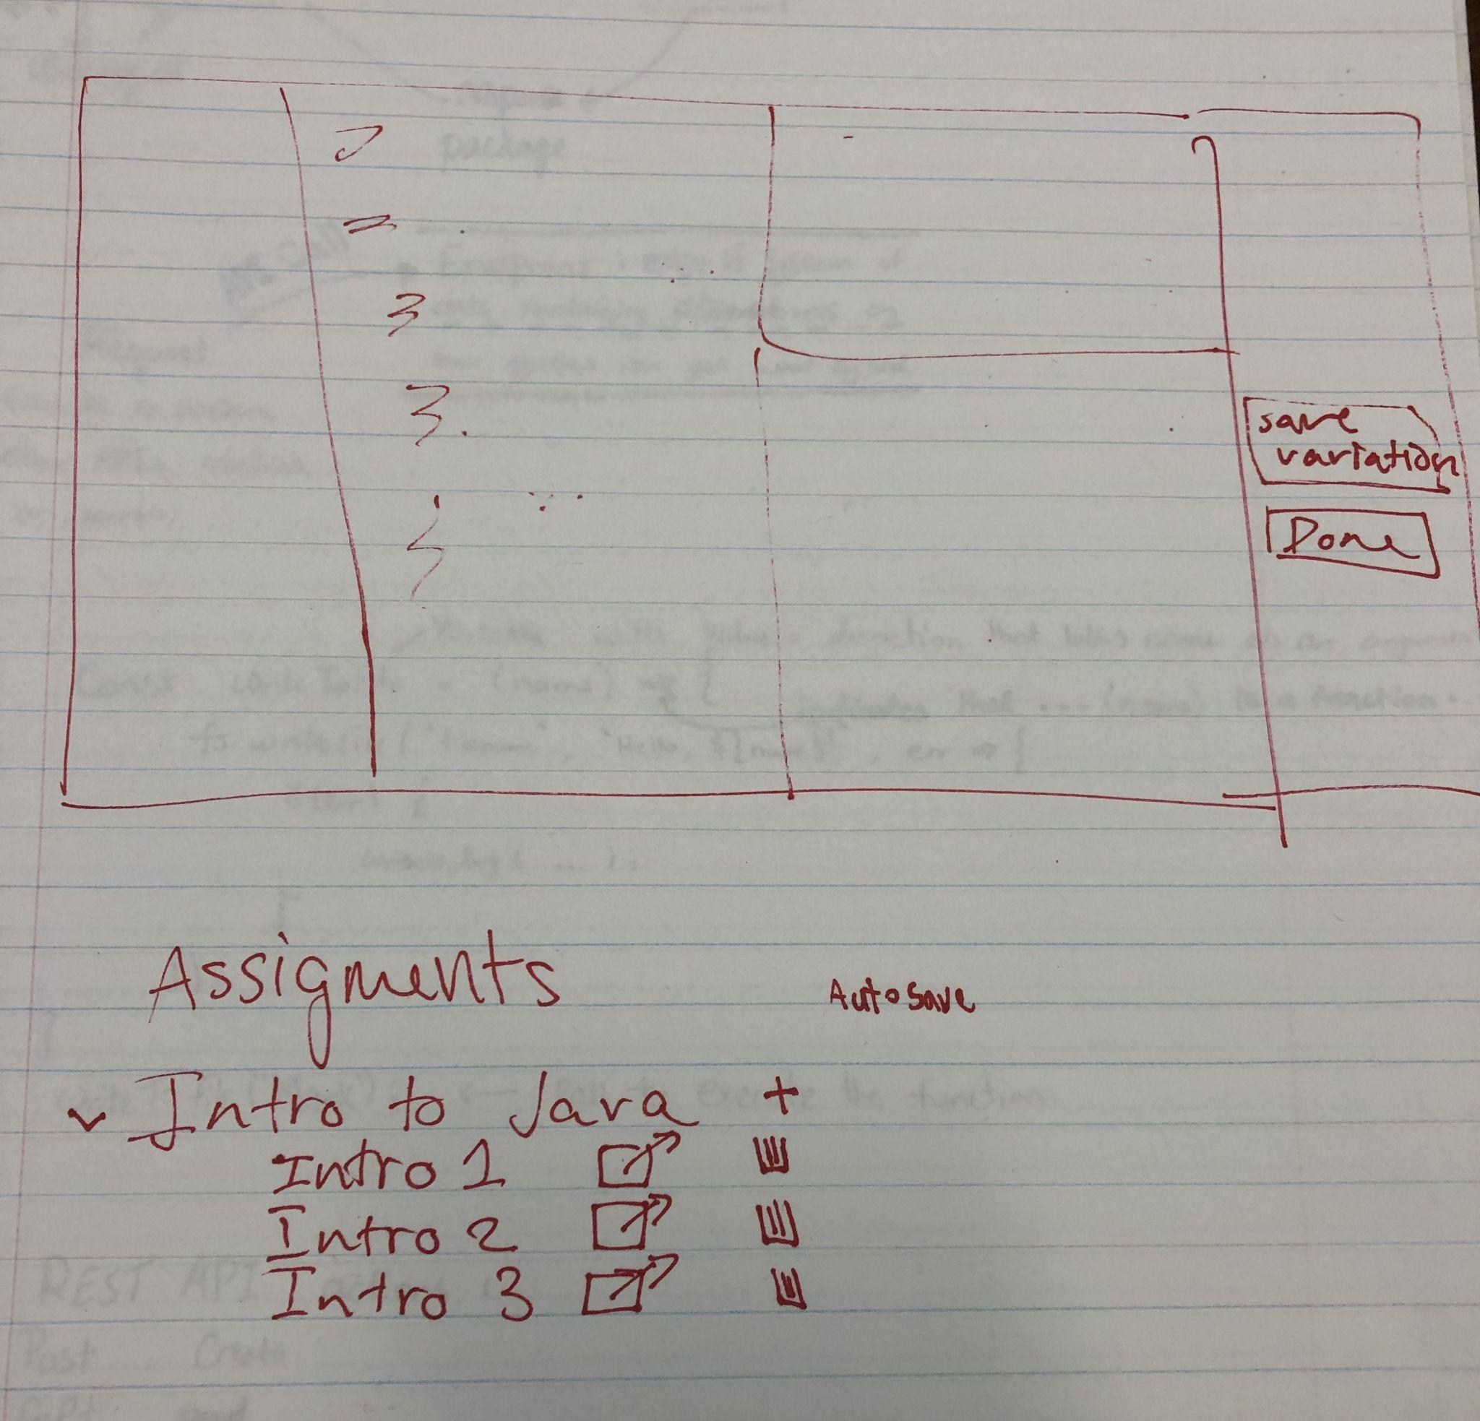
Final Design
Currently within the SnapClass, teachers can make an assignment and assign those assignments to different classes. The idea to the right is adding the feature to what currently exist within SnapClass. When a teacher creates an assignment, there will be an addition button (symbolized by the plus symbol in the picture) that allows the teacher to create different variations of the assignment.

Slide 11
Details About the Self-Assessment Feature
Teachers requested a self-reflection feature where students could reflect on their work before submitting assignments.

Slide 12
Design Ideas
Self-assessment rubric should be accessible from the side while students are working on their assignments
The rubric should be linked to their coding assignment so that when one gets turned in, so does the other. The assignment should also remind the student to self-assess themselves if they haven’t before turning in their assignment.

Slide 13
SnapClass Prototype
The teachers worked on a prototype for their ideas where they added functionality to screenshots of SnapClass. The prototype can be found below.
SnapClass Prototype

Slide 14
Contact
Maggie Lin
mclin@ncsu.edu
Sana Mahmoud simahmou@ncsu.edu
Please keep this slide for attribution

